Slide 1
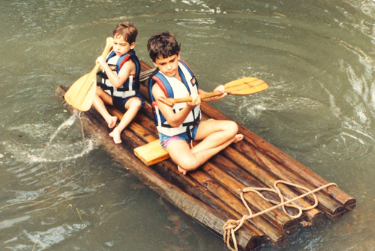
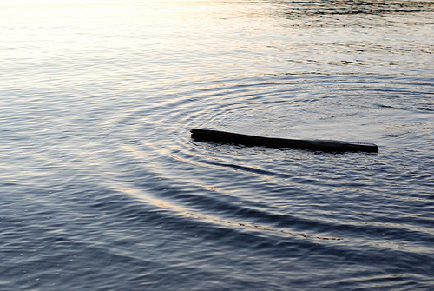
http://pugetsoundblogs.com/bremertonbeat/2008/12/page/2/#axzz2IMIBYZYC
http://www.paddlinghq.com/tag/accident.html

Slide 2
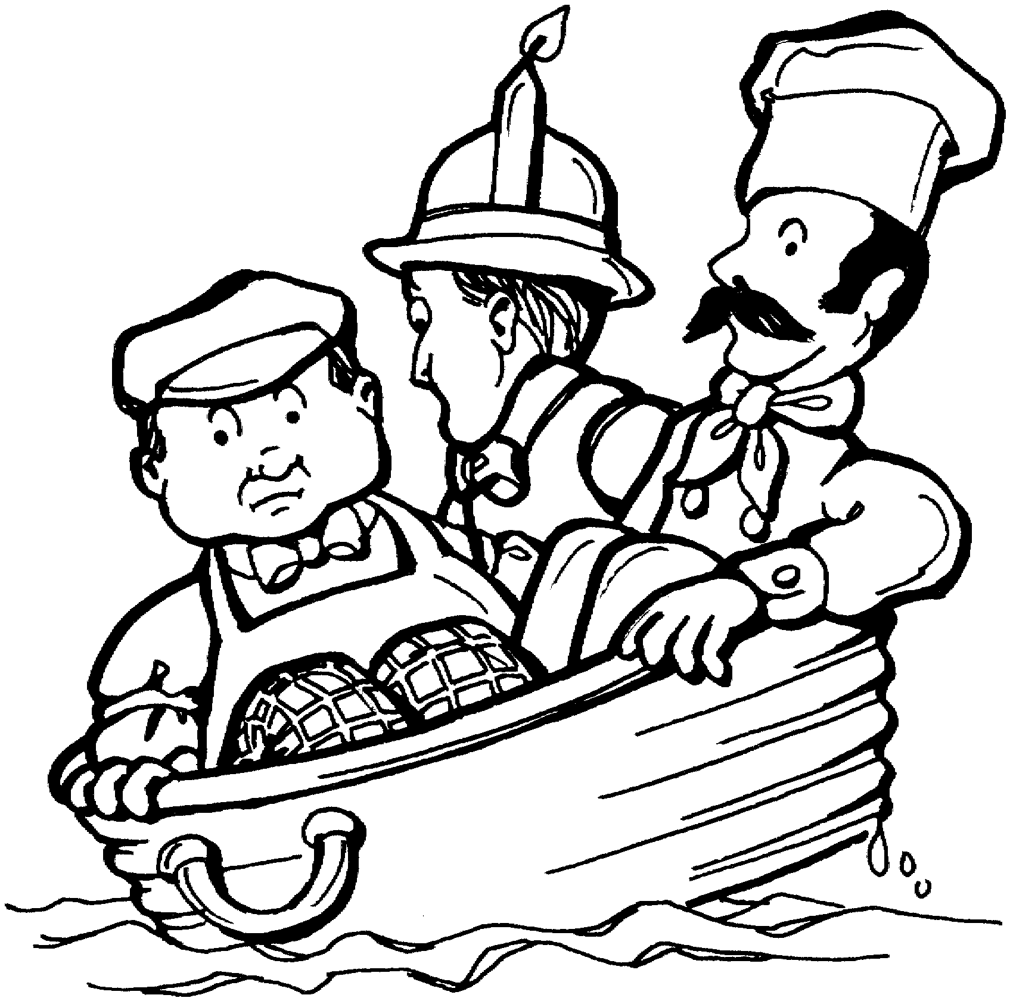
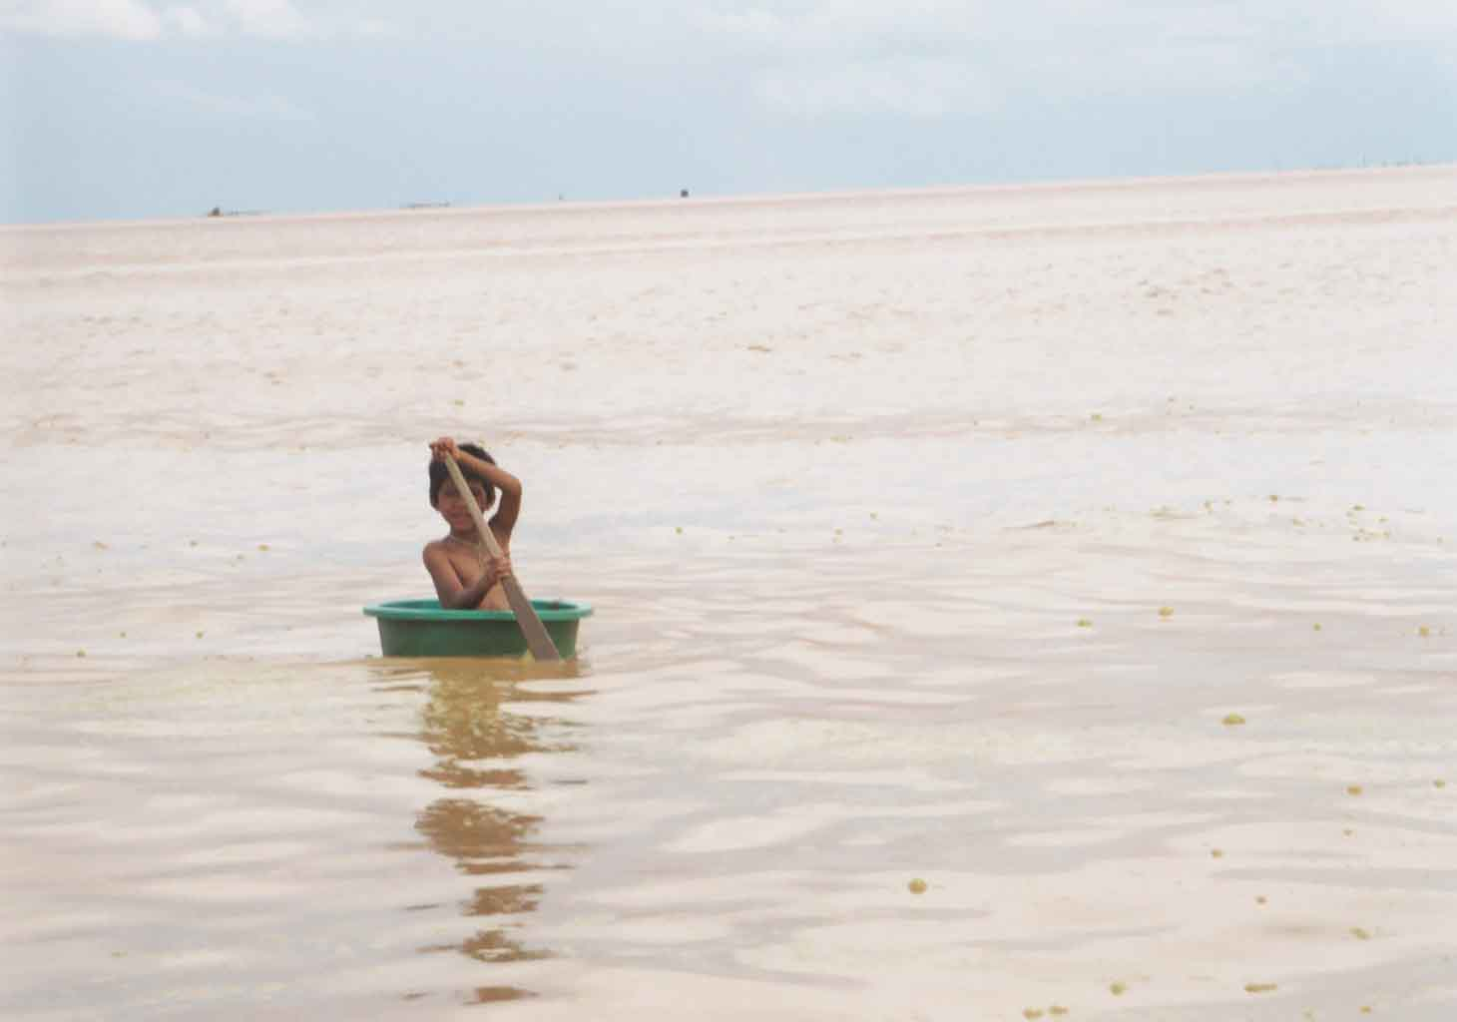
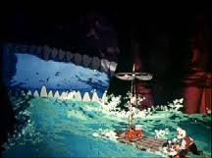
http://www.friendsacrossamerica.com/mgrubadub.html
Adam Pease
http://www.adampease.org/Cambodia/

Slide 3
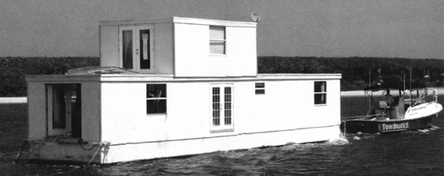
http://online.wsj.com/article/SB10001424127887324595704578244090452391864.html?mod=googlenews_wsj

